Slide 1
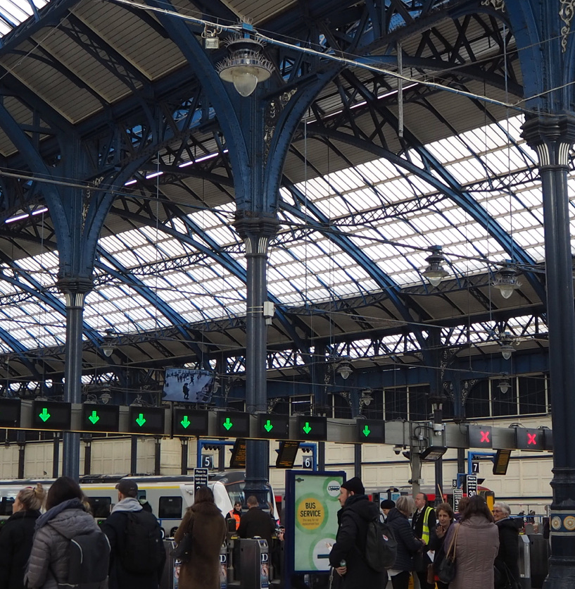
Common Assessment Tool
Better Value Rail

Slide 2
Theme | Questions
Strategic Objectives | What is the strategic objective? How does the transport need fit into to the wider strategy?
Transport Problem | What transport problem do you want this project to solve? Why is rail being considered as the solution, what alternatives have been considered?
Benefit Definition | What are the benefits you want to claim as a result of this project? Consider both transport and wider benefits; to what extent is the operator engaged in defining benefits?
Assumptions and Interdependencies | What is the significance of assumptions and impact of interdependencies that you have identified thus far? How have you been testing these as you work through the project? When are you planning to revisit your assumptions? In particular, how are you developing your cost assumptions and what is your approach to contingency?
Innovation | In the early stages, to what extent have you considered whether you are building the rail we have or the railway of the future? Are there examples of process innovation that you have developed or would have benefited from in the early stages?
Collaboration and Culture | Collaboration across rail industry partners is crucial to success. How are you set up to perform in those relationships and get from them what you need? What would you do differently at the start to get the best out of each organisation based on where your project is now? (NR/ORR/DfT and TOCs) Is there any best practice you have encountered?
Governance Arrangements | Have you considered your governance arrangements, set up and structure for early stages and how this might drive collaborative behaviour and accountability for risks? Do you know when you might reconsider governance arrangements as you move forward to future stages? (For example if you are considering light rail; if you are considering a non-traditional approach to delivery such as a joint venture) How far have you thought about who will operate the proposed service, what is the governance on this during construction, into operation and during operations?

