Slide 1
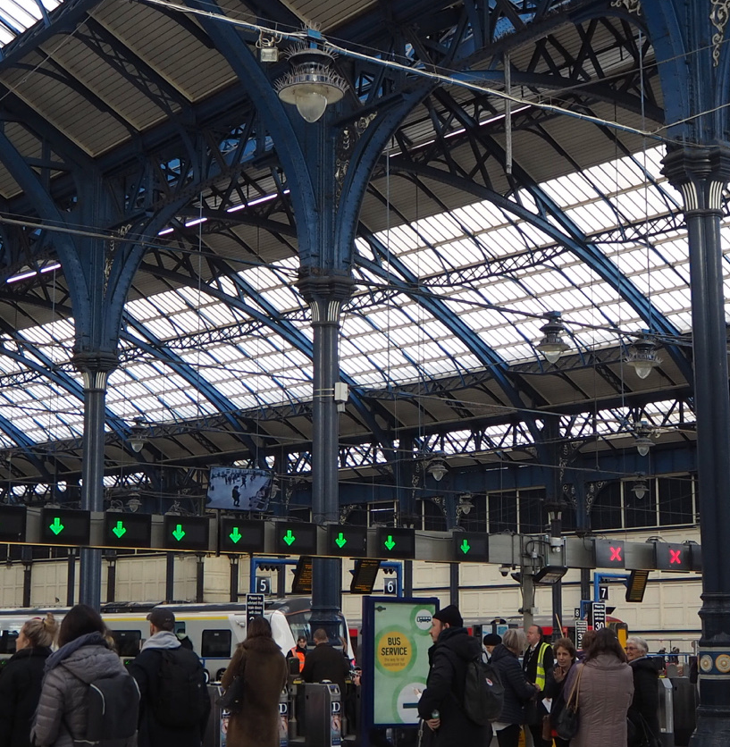
Common Assessment Tool
Better Value Rail

Slide 2
 | Low | Medium | High
Using established technology, or based on innovation? | All established | Some elements new, or new to rail | Prototype equipment
Estimated total cost | <£1m | £1m to £5m | >£5m
For a new line is the linear distance …? | <5km | 5km to 15km | >15km
For a new station is the estimated annual usage …? [NB ~68% have at least 100k per annum. Only ~35% have more than 500k per annum] | <100k | 100k to 500k | >500k
How many parties are involved in promoting the project? [This is entirely made up!] | 2 | 5 | Lots
Will there be interaction with the mainline railway? | None | Interchange | Part of it
Is the project on an established corridor or new route? | Mothballed line | Old formation | Greenfield
Are there SSSI/ancient monuments/AONB etc.? | None | Nearby | In the way
Does the route have geological issues, i.e. mining area, floodplain etc. | All solid ground | Some isolated areas of uncertainty | Large areas of floodplain or unknown geology
Is the transport project independent or part of a larger programme of development? | Independent | Complementary to other planned development | Necessary to permit other development
Are statutory permissions required? | Local planning consent only | Development Consent Order | Transport and Works Act Order
How many people in total will be required to develop and construct? | <5000 | 500 to 1,000 | >1,000
Etc…… [how far to go – needs to be a manageable list of indicators rather than all-encompassing]

