Slide 1
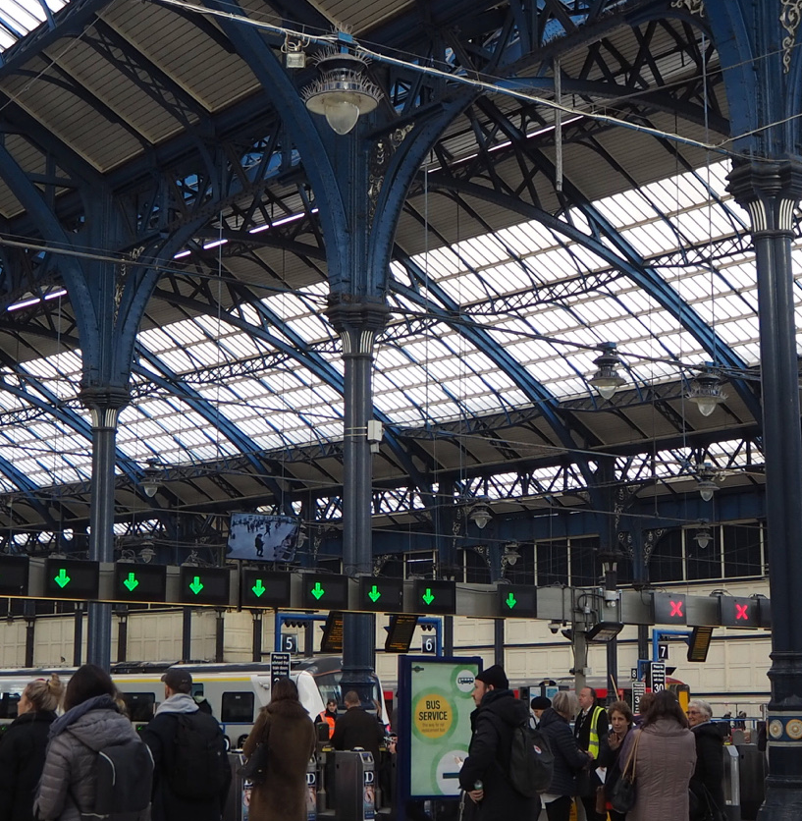
Early Stage Specification Tool
Better Value Rail

Slide 2
2nd Option: trade off in the timetable
1st Option: change the timetable
3rd Option: change the rolling stock
4th Option: change the infrastructure
We should always remember the hierarchy of schemes for effective development:
Can we deliver the output change now with the network as it is, simply by changing the timetable?
Are there any trade-offs in train services that will allow us to deliver the output change with the network as it is by changing the timetable?
Can we deliver the output change through a change in rolling stock alone?
Does the output change require us to change the infrastructure?

